Slide 1

A web application tool for SUTD students to search for and pre-schedule courses.
https://github.com/TsukiSky/SUTDTimePlanner

Slide 2
Introduction
A web application designed to transform the course planning process for our SUTD students, enabling searching and pre-scheduling courses.
Challenges Now Students Face With
Motivation
Website Showcase
Request for Official Supports
Notes:
Good [Morning/Afternoon]. My name is Siqi, a year 4 student here at SUTD.
Today, I will be introducing you the SUTD Time Planner developed be me, A web tool for SUTD students to search for and pre-schedule courses. a revolutionary tool designed to transform the course planning process for our fellow SUTD students."
Key Points to Be Covered: "Throughout this presentation, I will highlight the challenges students face with course planning, showcase the benefits of the SUTD Time Planner, and request your support in providing the official course data needed to make this web application a reality."
Engaging Question: "But first, let me ask you: How often have you seen students struggle with selecting courses, managing their schedules, and avoiding time conflicts? The SUTD Time Planner aims to address these challenges head-on."
Transition Statement: "Now, let's delve into the details and discover how this innovative web application can transform the course planning experience for SUTD students."

Slide 3
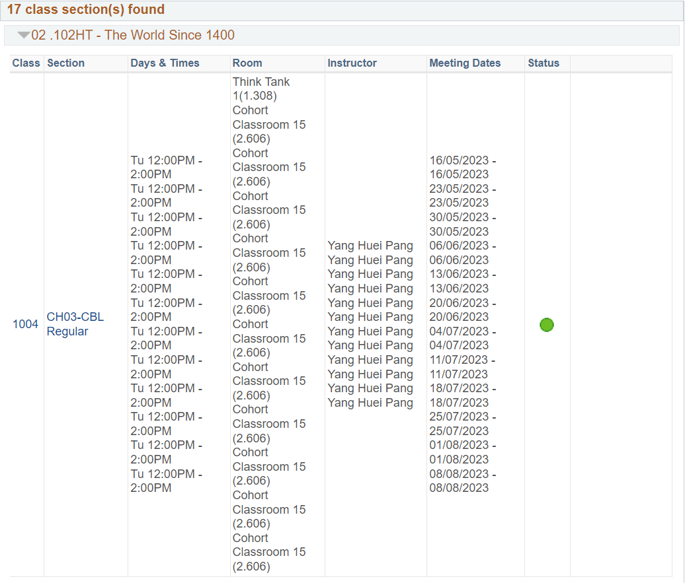
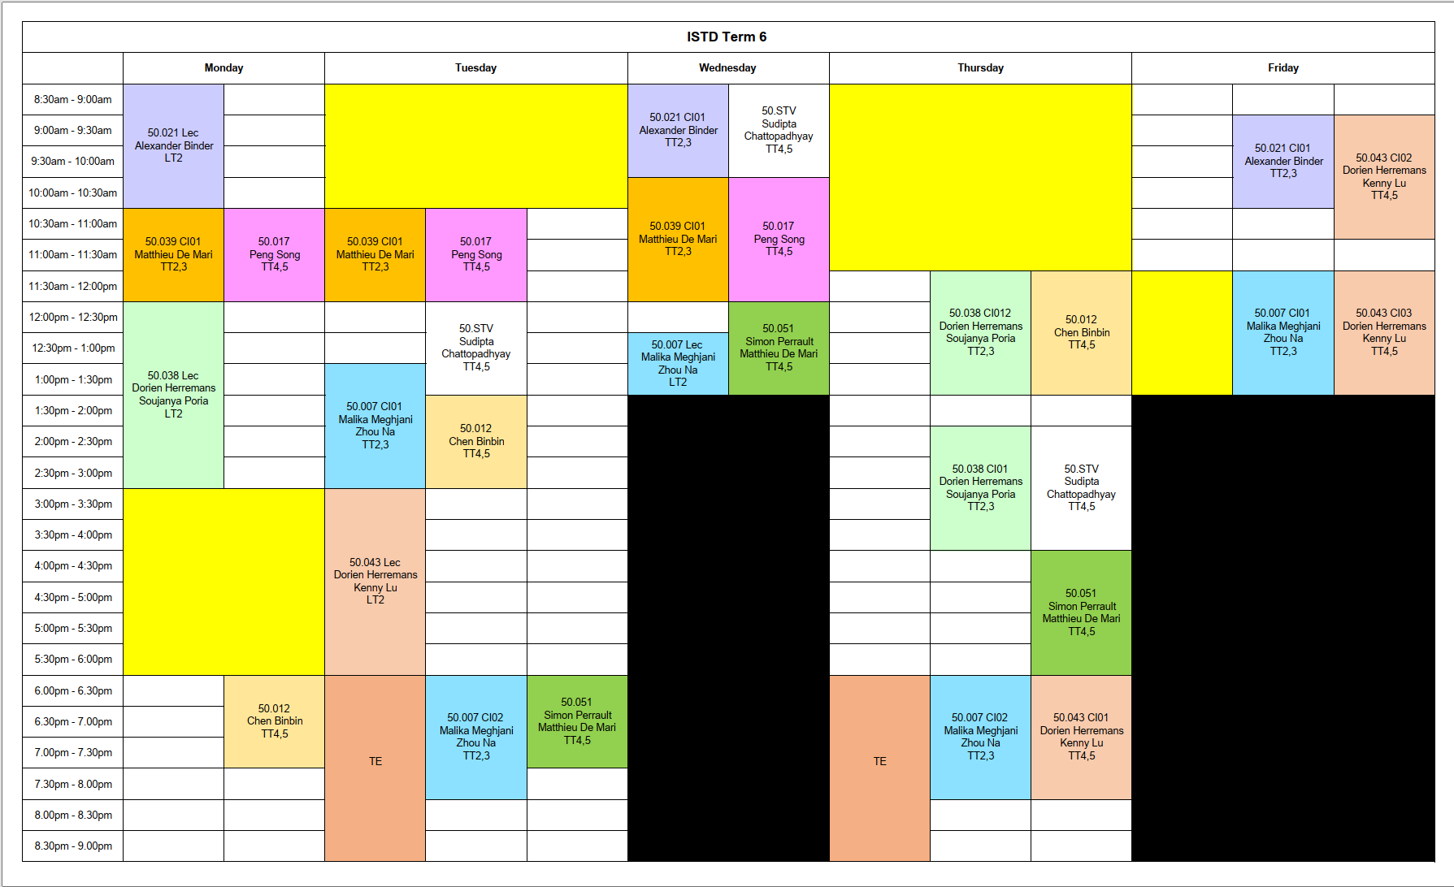
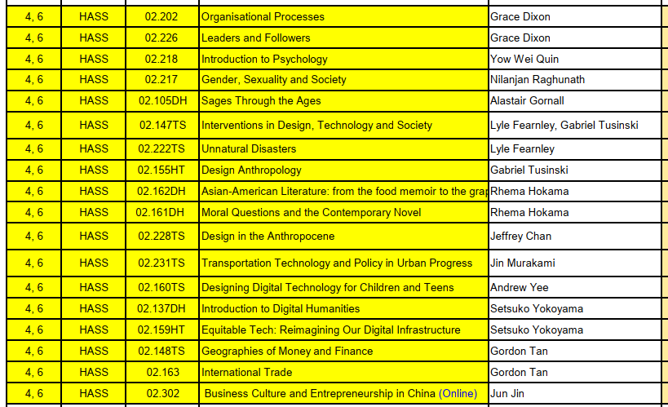
Challenges
IF conflicts are found in the enrolling stage, I will have no choice but re-enroll all courses! I will be slow, and I won’t have time to make a second plan, what if there are conflicts again!
Which course should I enroll?
Is there any time conflict?

Slide 4
Solution
A website for students to schedule their courses before the enrollment starts!
Schedule courses with a timetable
Search
“Enroll” & “Drop”
“Mark for another plan”
Detect time conflicts
Download the timetable
Many students prefer to use the course timetable as their wallpapers

Slide 5
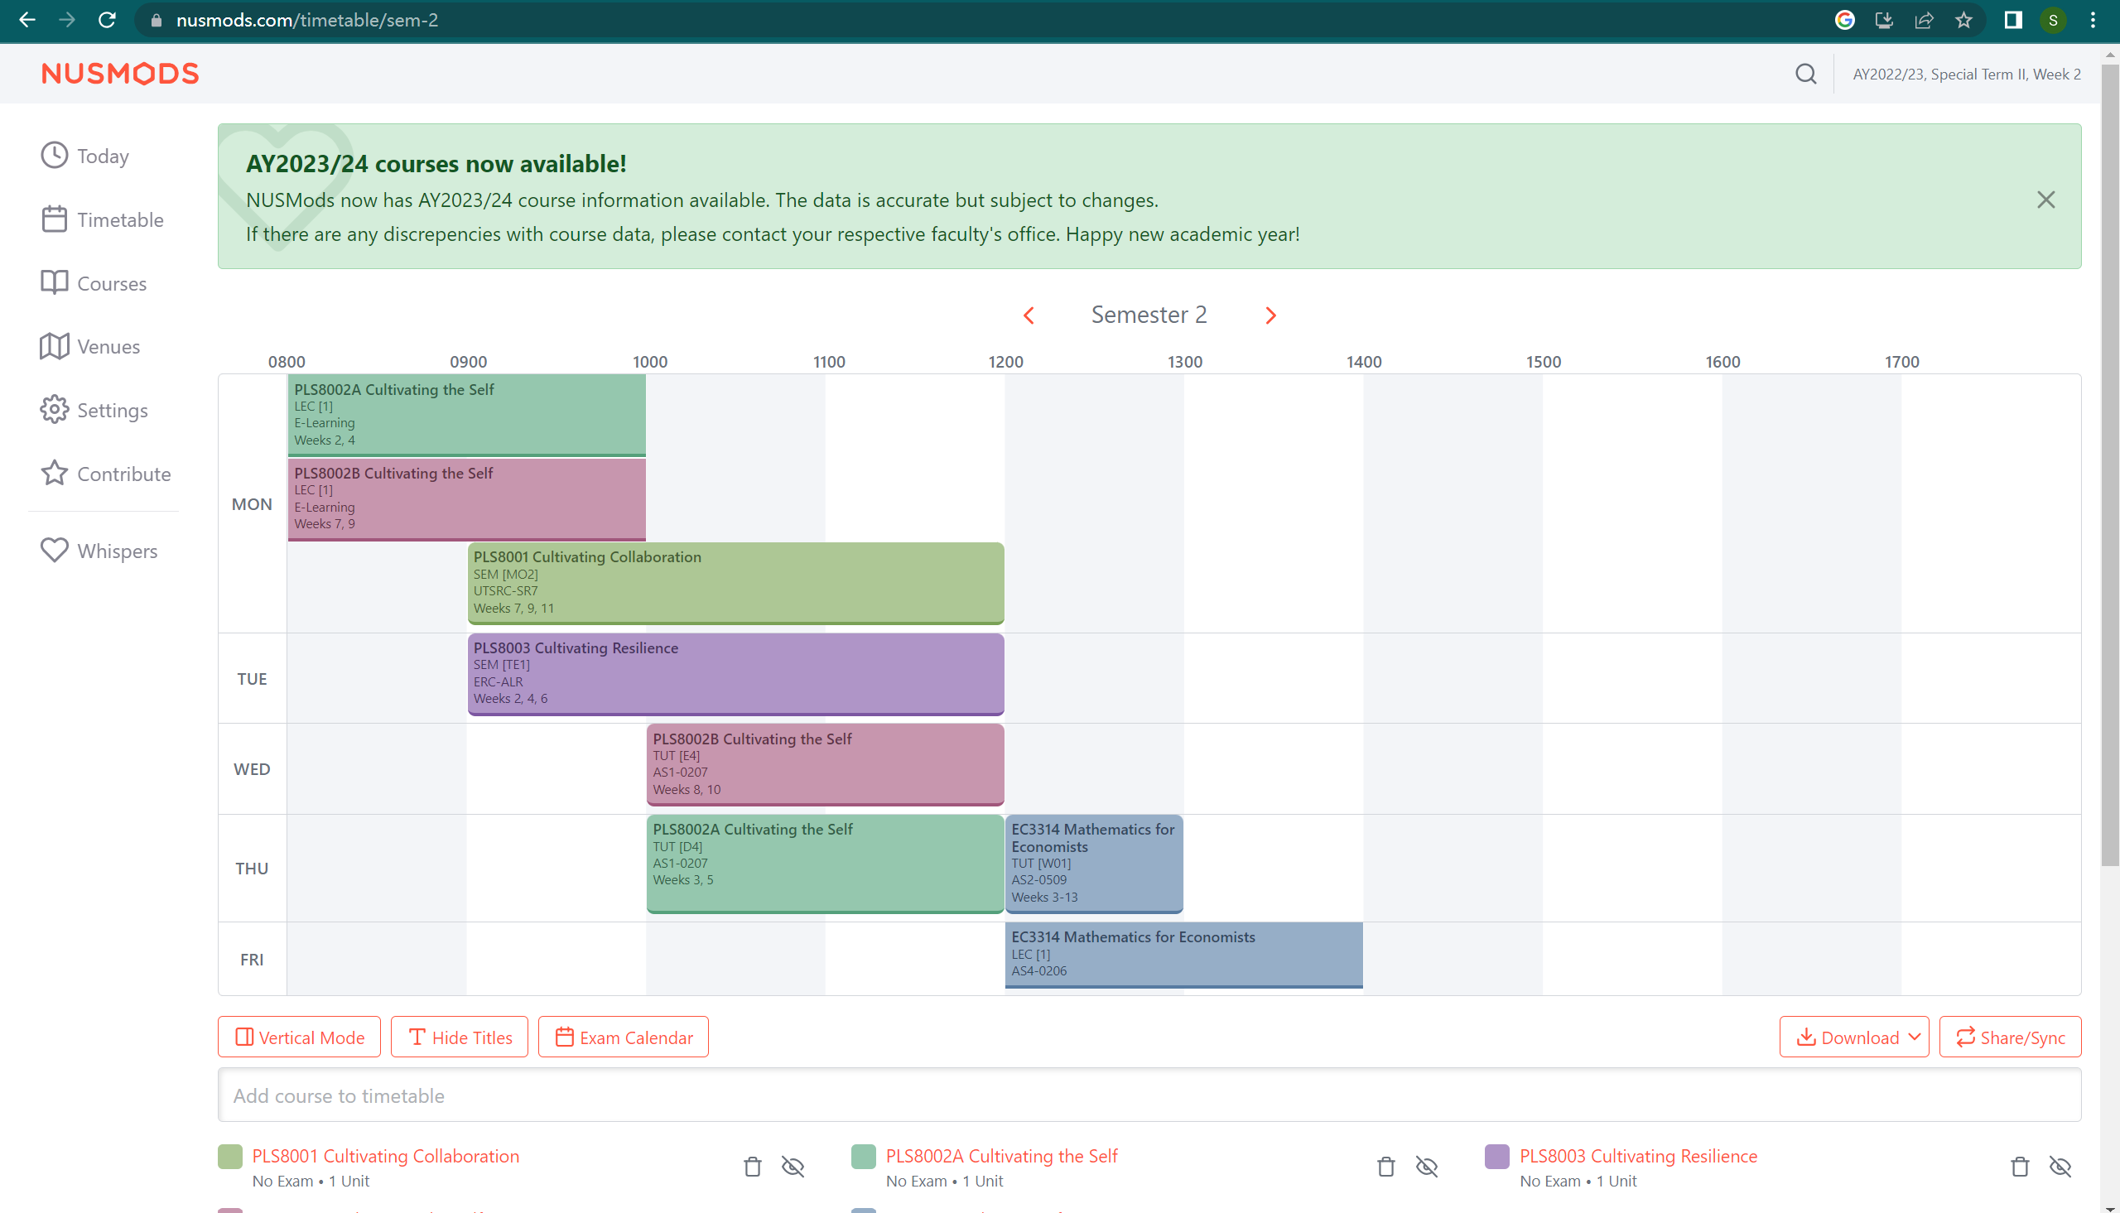
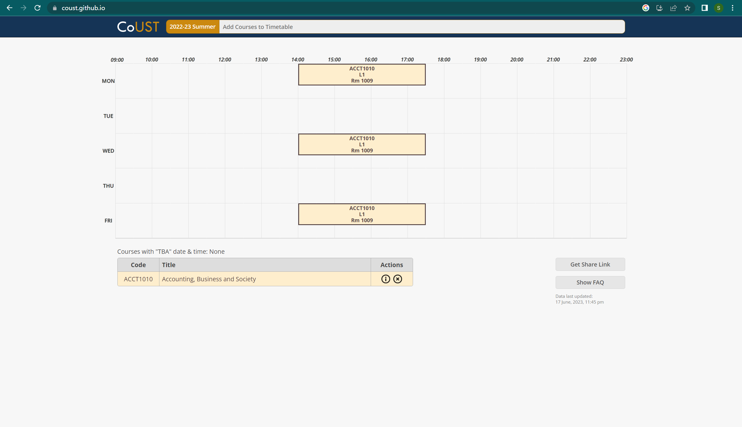
Motivation
Last term, I went to HKUST for an exchange, and I saw them facing the same issue and some of their students developed this.
https://coust.github.io/

Slide 6
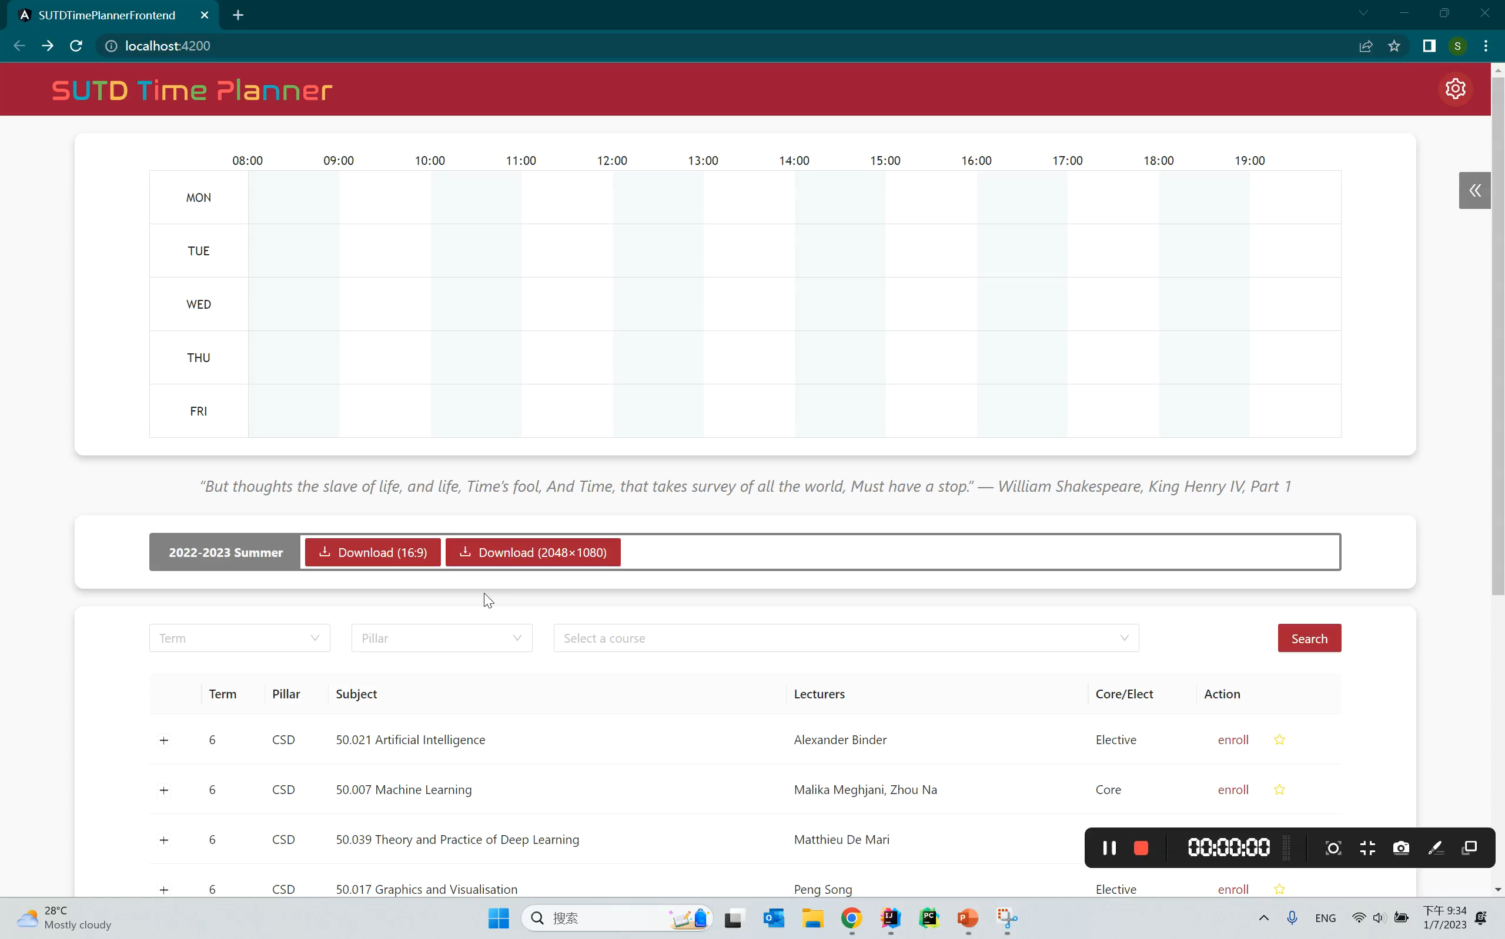
Showcase

Slide 7
Request for Official Supports
I need the official course times before each enrollment / term starts.
If this project can be further supported by school, some UI design suggestions such as themes and fonts choices would be very helpful, to align this website with the theme of SUTD officials.
The website could serve as a student developed tool to support SUTD students’ course enrollments.

Slide 8

THANK YOU!
https://github.com/TsukiSky/SUTDTimePlanner

